Slide 1
Project Meeting - Initial Phase
Team Lotus

Slide 2
What we know so far.…
We got information from MRC
MySQL
PHP 7.4
HTML, CSS, Javascript

Slide 3
HTML, CSS, Javascript
MySQL
PHP 7.4
Webpage

Slide 4
EECS
20
Ggg
5

Slide 5
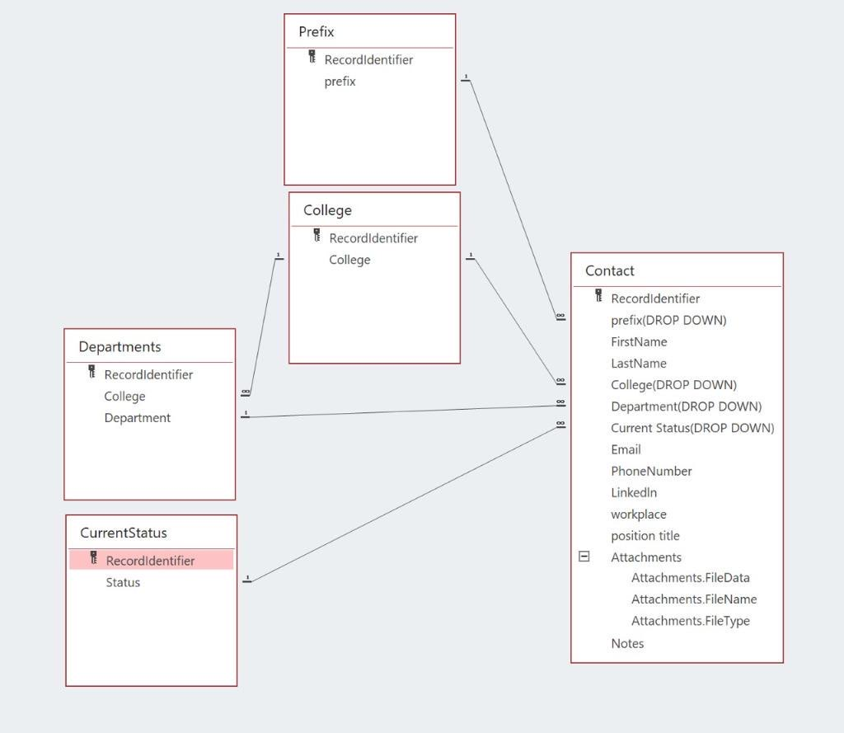

Slide 6
Thank you
Team Lotus

